Slide 1
Improving the prototype

Slide 2
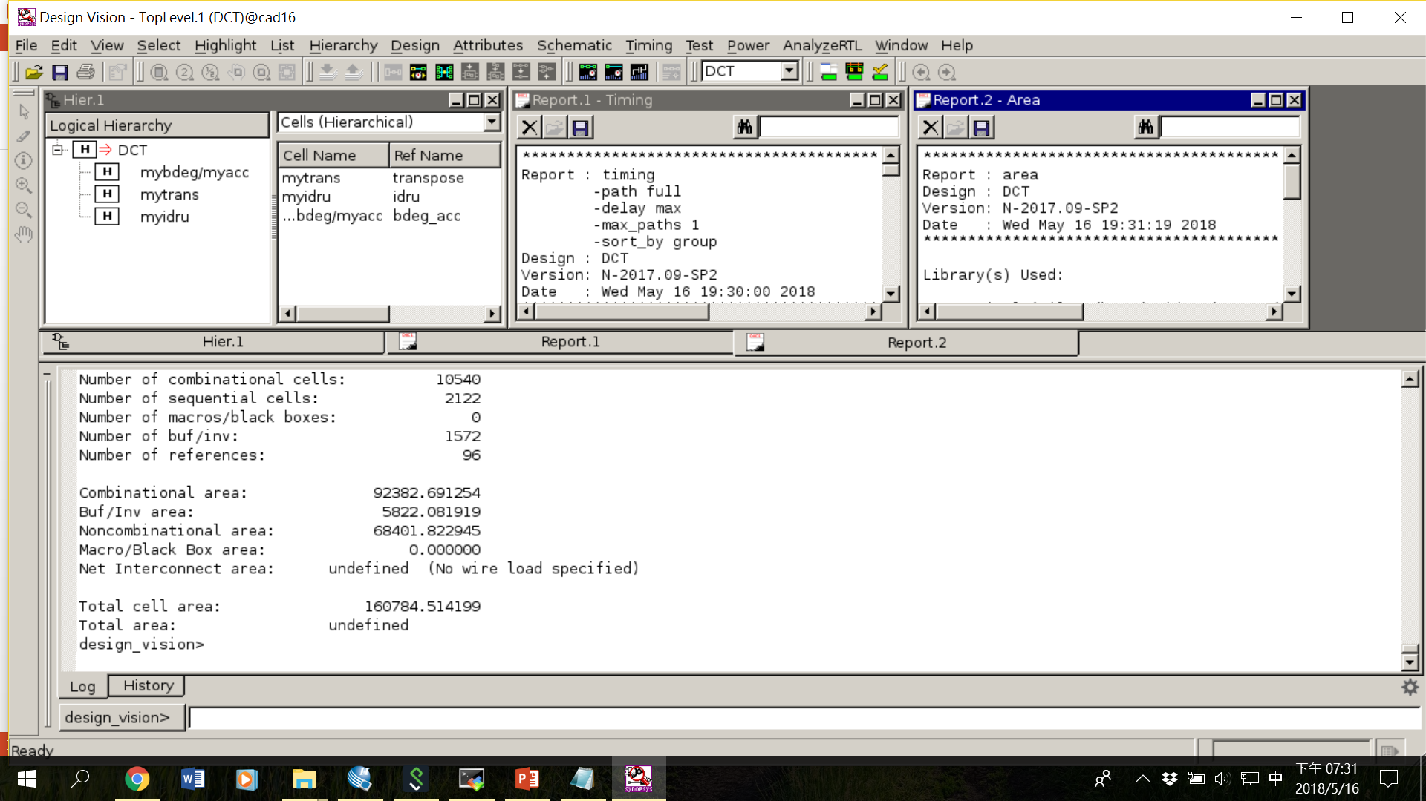
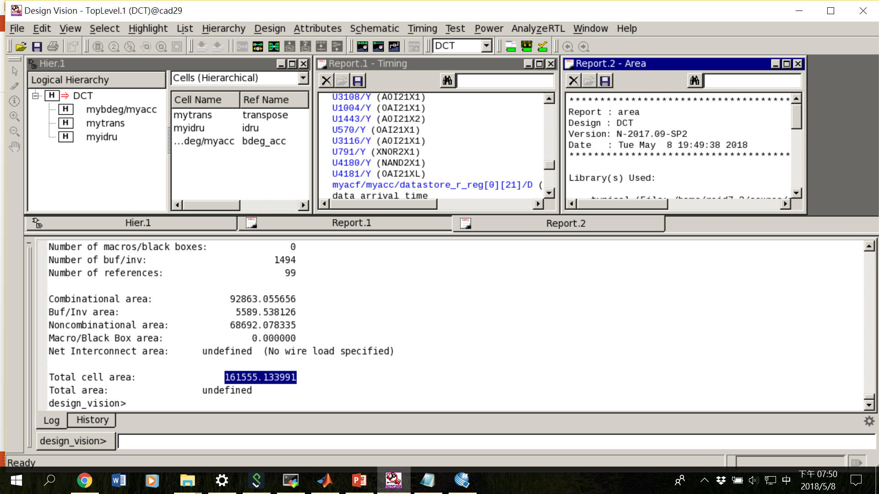
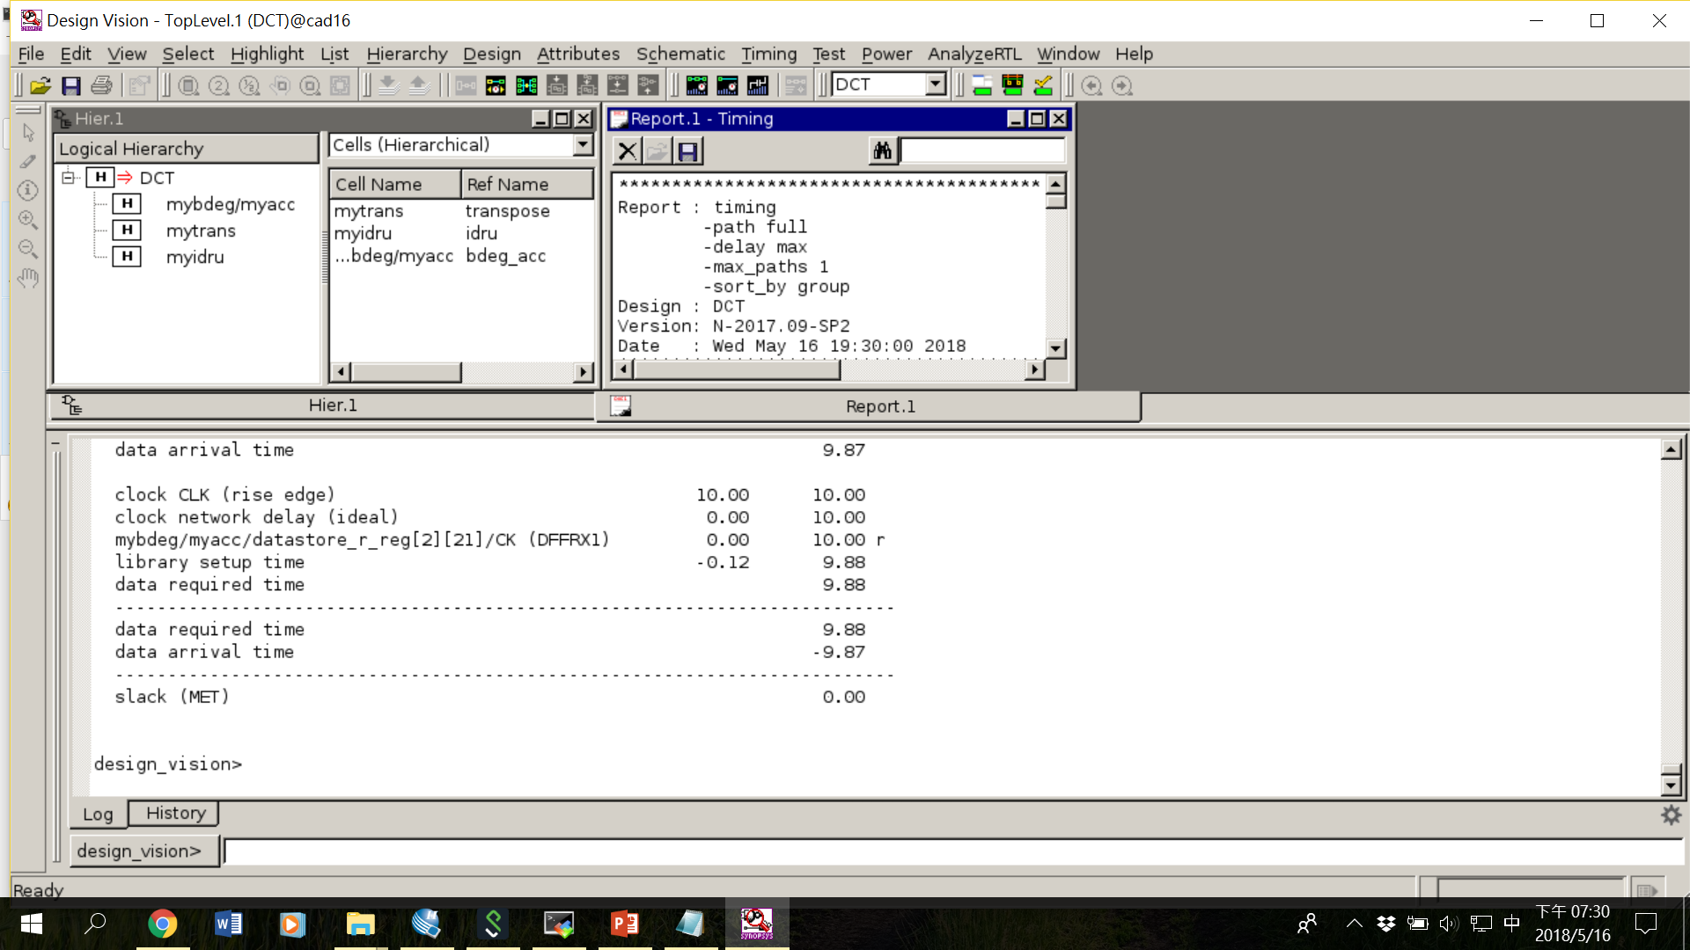
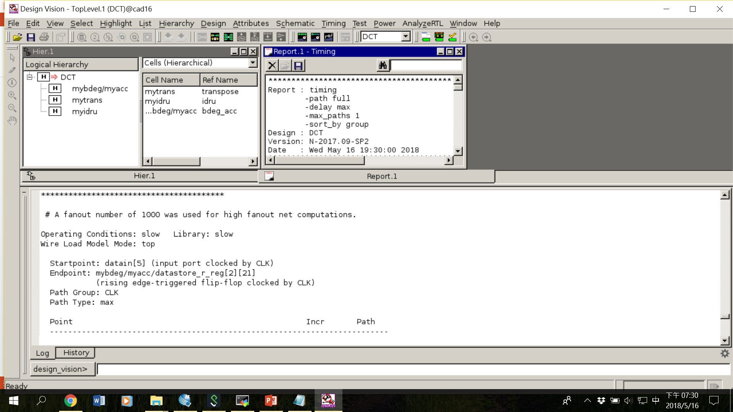
Share the same finite state machine

Slide 3
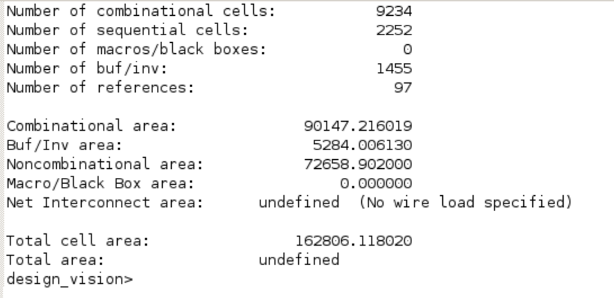
Use shift-registers in transpose_mem
The total area increases due to the additional non-combinational circuit
Requires buffers to store the temporary data, 8*22=176bits
Latency is 8 cycle higher

Slide 4
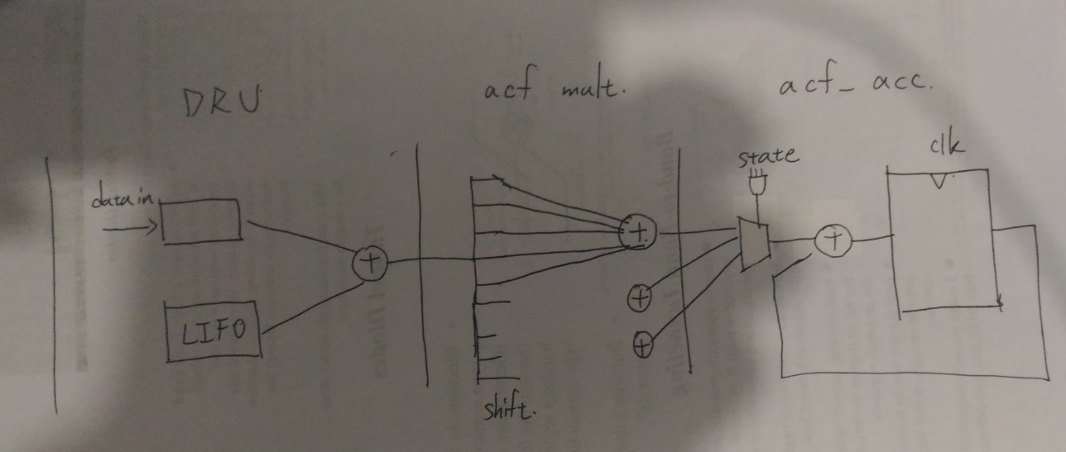
Pros: Reducing critical path, since the output from transpose_mem does not go through the 64-to-1 MUX.
Output from transpose_mem

Slide 5
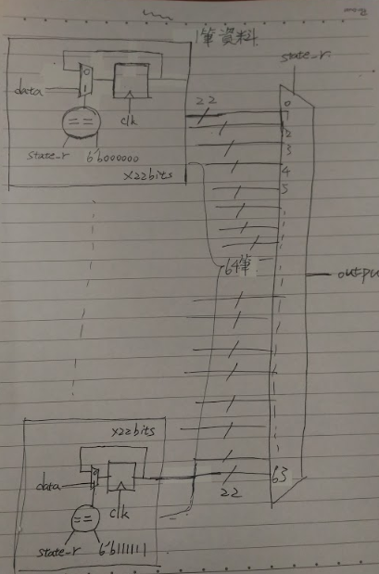
64 to 1 MUX

Slide 6
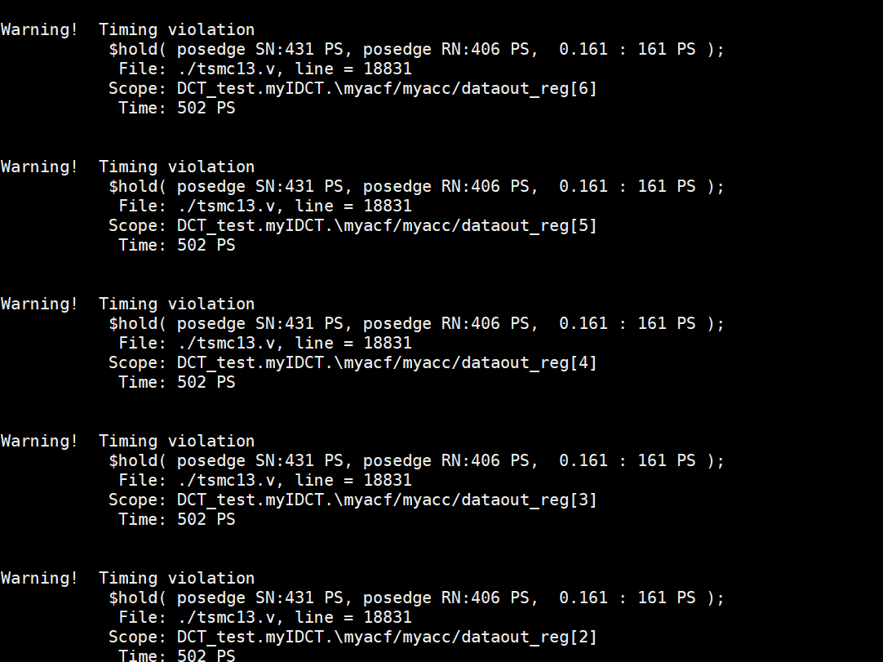
Gate level simulation shows violations

Slide 7
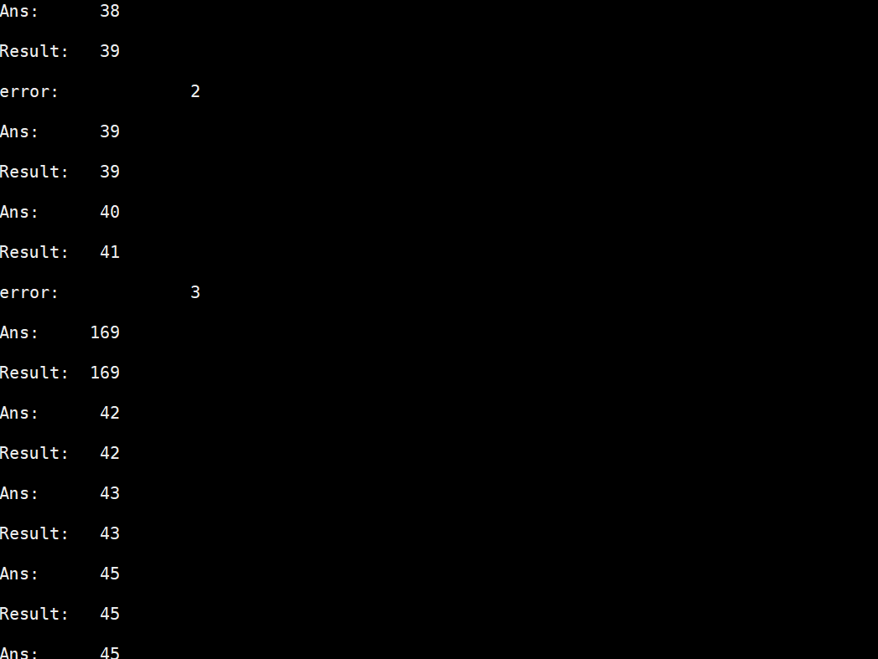
But the results seem to be correct

Slide 8
TODOs
More pipeline?

